Slide 1

Babbar Rajput Bank
Yash:-40724402017
Sanklap:-06324402017
Jaspreet:-42024402017

Slide 2
1. Introduction 2. Objective 3. Methodology 4.SDLC Model 5. Block Diagram 6. ER-Diagram 7. Use case 8. Data Flow Diagram(0-level,1-level,2-level) 9. Gantt chart 10. Future Scope 11. Conclusion
content

Slide 3
Introduction
Banks are quite important to the economy and are involved in such economic activities as issuing money, settling payments, credit intermediation, maturity transformation and money creation in the form of fractional reserve banking.
To make money, banks use deposits and whole sale deposits, share equity and fees and interest from debt, loans and consumer lending, such as credit cards and bank fees.
Banking systems have been with us for as long as people have been using money. Banks and other financial institutions provide security for individuals, businesses and governments, alike.
In general, what banks do is pretty easy to figure out. For the average person banks accept deposits, make loans, provide a safe place for money and valuables, and act as payment agents between merchants and banks.
The whole banking management System is developed in java for backend coding we use java for the frontend development we use javafx.

Slide 4
Objective
To develop a software for solving financial applications of a customer in banking environment in order to nurture the needs of an end banking user by providing various ways to perform banking tasks. Also to enable the userâ„¢s workspace to have additional functionalities which are not provided under a conventional banking software.

Slide 5
Methodolody
We have used ITERATIVE WATERFALL MODEL
This model contains :
Feedback paths- In iterative waterfall model feedback path from one phase to its preceding phase allows correcting the errors.
Simple: Iterative waterfall model is very simple to understand and use.

Slide 6
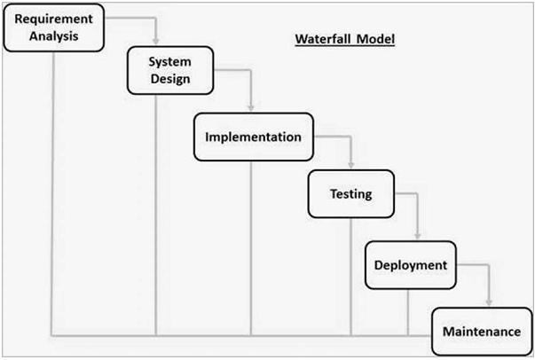
SDLC Model
For software development we are using Waterfall model which help us in changing data in any level of development phase.
And at any level we can go back to any step for the updating of anything in project

Slide 7
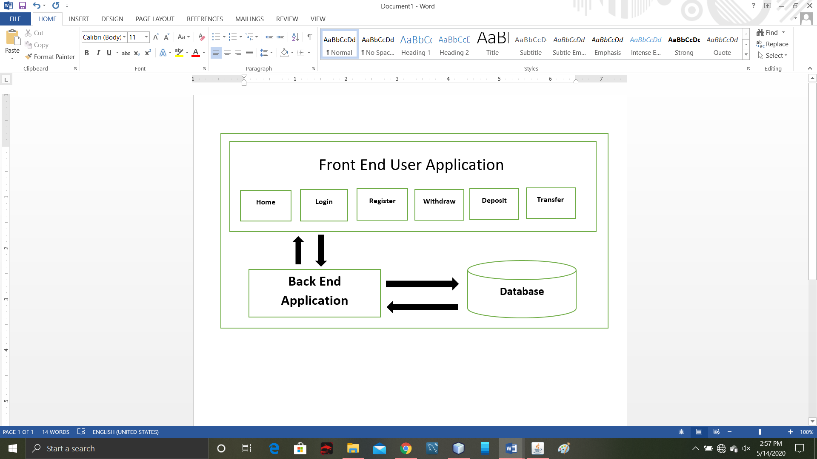
Block Diagram

Slide 8
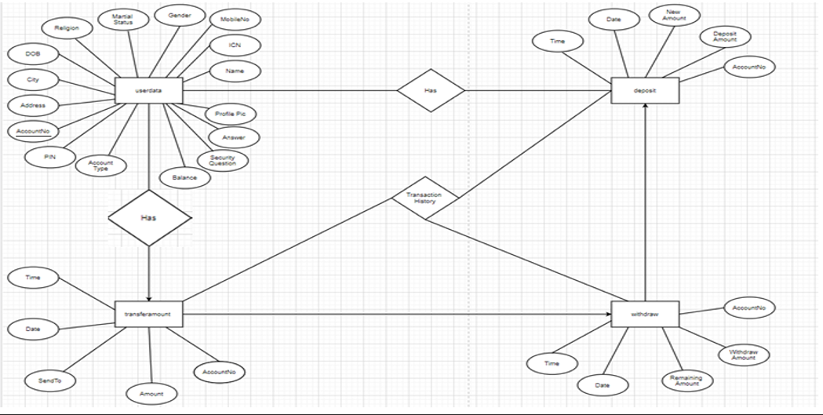
ER-Diagram

Slide 9
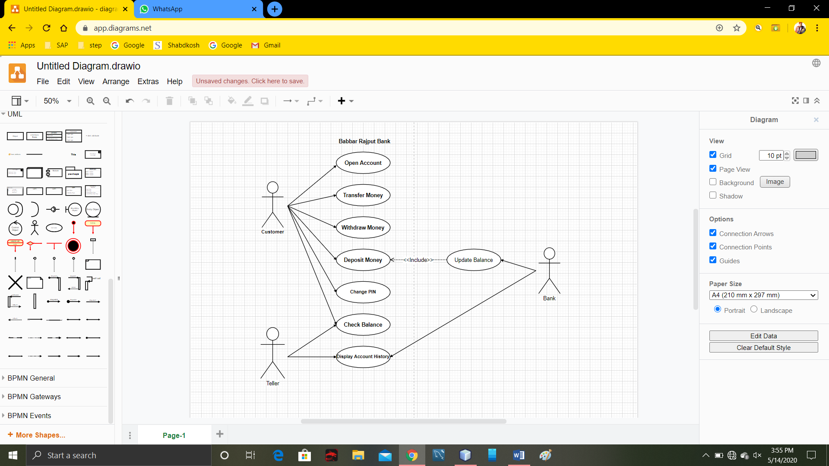
Use case

Slide 10
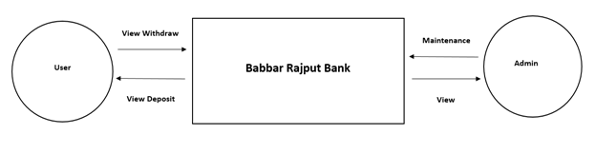
Data Flow Diagram 0-level

Slide 11
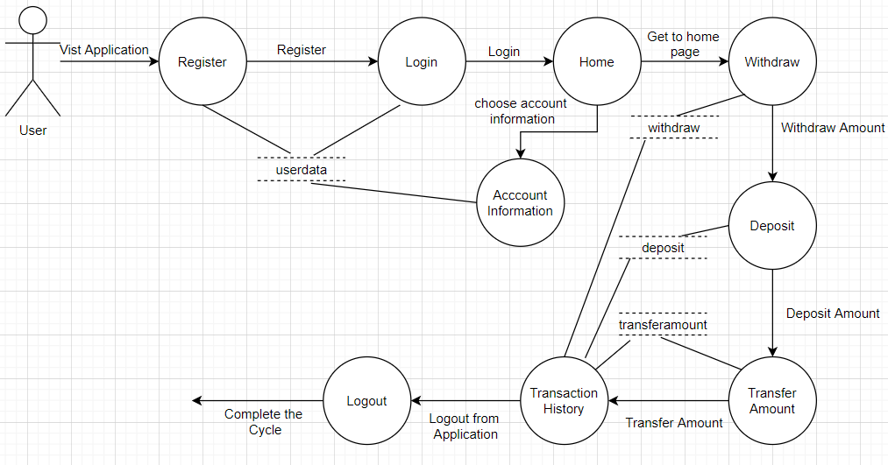
Data Flow Diagram 1-level

Slide 12
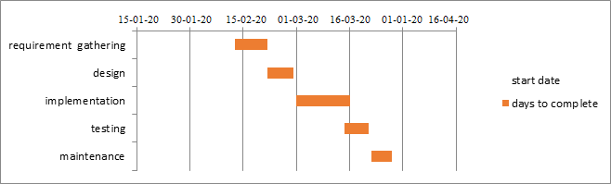
Gantt Chart

Slide 13
Future Scope
1. The Future scope of this project is that we can take our offline database to online database with the help of google firebase,
2.Create Website and Android Application with connectivity to more banks and add more payment module like:-
Paying on food stalls
Pay on shops
Pay electricity bill and many more.

Slide 14
Conclusion
Nothing is perfect in the world. So I am also no exception. I have tried my best to build this project with efficient information. I do not permit the project to be 100% accurate. This project help the all customer which have multiple bank account in different banks . Due to this the time customer save own time and they easily login on this application and make transaction easily. The main focus of this project is to save the customer time which have multiple bank account can transfer money easily.
The maintenance of the records is made efficient, as all the records are stored in the Oracle database, through which data can be retrieved easily.
We finally conclude that using this project we can provide a great interface between the user and the banking environment, thus satisfying the requirements of multiple users. It provides an efficient ways for people to involve in on-line transactions. We are providing a monitoring mechanism for admin which is having the ultimate power.
And finally the users will be satisfied with our service.

